Slide 1
Email Area of Interest Modeling Discussion
Andrew Gutierrez
Data Scientist
Cleveland Clinic Philanthropy

Slide 2
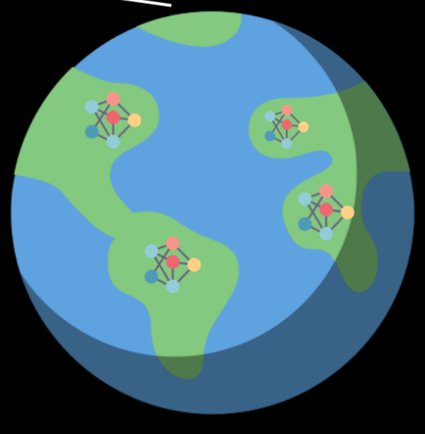
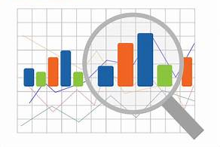
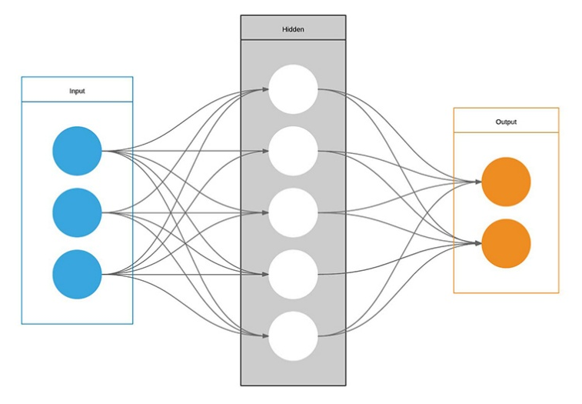
Overview of the Data Science Process
3. Implementation
1. Explore Data and Find Insights
2. Build Predictive Model
Notes:
Designing samples
Exploring data
Tests

Slide 3
Part I: Setting Up Our Exploration

Slide 4
Data Analysis
Data Analytics vs. Data Science
Looking backward;
Telling what happened in the past
Data Science
Looking ahead;
Trying to predict what will happen in the future
Notes:
Designing samples
Exploring data
Tests

Slide 5
Our Dataset – “Potential Giving Years”
Five-year “snapshots” for each of our constituents (2021 – 2025)
Had to have been solicited via appeal within that year
Over 4 million total records in data sample
Our Target – “Did They Make a Gift (Y/N)?”
Broken out into the following areas:
General Giving | Neuro | Pediatric | Heart (HVI) | Cancer | Cancer (Non Peer-to-Peer)
Notes:
For each year:
Did they give in general?
Did they give to Heart/Neuro/Cancer/Pediatric?
What did their patient experience look like that year?
What about in the previous year(s)? What was their giving history/patient experience?

Slide 6
Our Supporting Data…
Past Giving History | Patient Visits | Email Clicks | Event Attendance
 | Prospect A | Prospect B
Year | 2024 | 2024
Made a Gift? | N | Y
Previous Year Giving | $100 | $1,000
Patient Visits | 0 | 4
Attended Event | N | Y
 | Prospect B | Prospect B
Year | 2024 | 2025
Made a Gift? | Y | N
Previous Year Giving | $1,000 | $100
Patient Visits | 4 | 0
Attended Event | Y | N
Notes:
For each year:
Did they give in general?
Did they give to Heart/Neuro/Cancer/Pediatric?
What did their patient experience look like that year?
What about in the previous year(s)? What was their giving history/patient experience?

Slide 7
Past Giving History
For each “potential giving year”, what did their past giving history look like?
Recency | Frequency | Monetary Value analysis (RFM)
R: Time since most recent gift
F: Number of past gifts
M: Lifetime Giving
Further breakouts by “recency segment”
Giving in past 0-18 months (“House donor”)
Giving in past 19-36 months (“Lapsed donor”)
Giving in past 37-60 months (“Long lapsed donor”)
Other fields
Age
Region of residence
Wealth Rating (capacity)
Qualified Annual Giving (QAG)
High Annual Giving (HAG)
Notes:
Further broken out into our giving areas (giving to neuro, pediatric, heart, cancer, cancer non peer-to-peer, etc.)

Slide 8
Patient Visits
For each “potential giving year”, what did their past patient experience look like?
Recency | Frequency analysis
R: Time since most recent visit
F: Number of past visits
Further breakouts by patient “recency segment”
Appts in past 0-18 months (“Recent patient”)
Appts in past 19-36 months (“Lapsed patient”)
Appts in past 37-60 months (“Long lapsed patient”)
Further breakouts by:
Inpatient visits
Surgeon visits
Other fields
Primary visit location
Presence of child in household
Notes:
Further broken out into our giving areas (visits to neuro, pediatric (child), heart, cancer, etc.)

Slide 9
Email Clicks
For each “potential giving year”, what emails were they clicking on and how often?
Recency | Frequency analysis
R: Time since most recent click
F: Number of past clicks
Further breakouts by email “recency segment”
Clicks in past 0-18 months (“Recent”)
Click in past 19-36 months (“Lapsed”)
Click in past 37-60 months (“Long lapsed”)
Notes:
Further broken out into our giving areas (giving to neuro, pediatric, heart, cancer, cancer non peer-to-peer, etc.)

Slide 10
Event Attendance
For each “potential giving year”, what events had they attended?
Attended event in past? (Y/N)
Number of past events attended
Time since last event
Breakouts by area:
Neuro (Power of Love, etc.)
Pediatric (Derby Day, Gala, etc.)
VeloSano breakouts:
Past rider/virtual fundraiser? (Y/N)
# of past years participated
Past total raised
Past number of donations
Historical % to goal
Years since last participation

Slide 11
Part II: Reviewing Our Findings

Slide 12
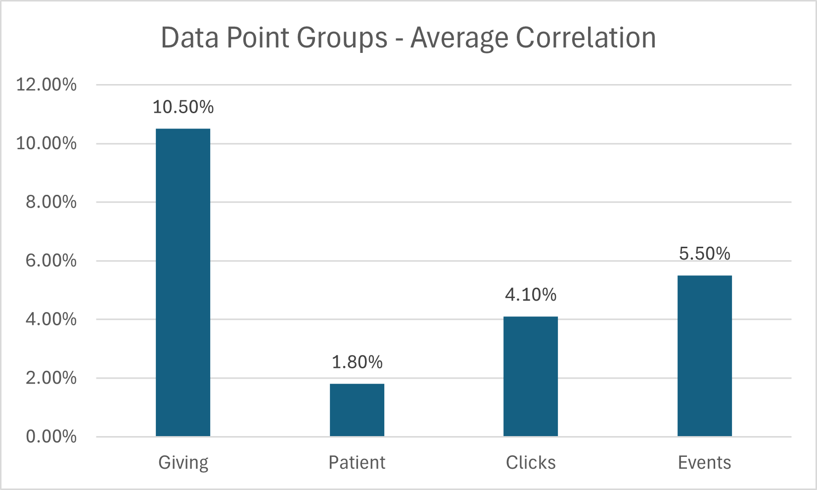
1. Past Giving History is King
The single best predictor of someone making a gift this year, is if they’ve made a gift in a previous year.

Slide 13
1. Past Giving History is King
Conversely, the best predictor of someone not making a gift this year is if they’ve haven’t made a gift in the past
 | General Giving | Neuro | Pediatric | Heart (HVI) | Cancer | Cancer (Non Peer-to-Peer)
Top Correlating Variable - Positive | House Donor (34.2%) | Neuro Gifts, Last 18 Months (26.6%) | Pediatric House Donor (21.5%) | Heart Gifts, Last 18 Months (21.8%) | Cancer House Donor (29.8%) | Cancer House Donor (20.4%)
Top Correlating Variable - Negative | No Prior Donations (-32.8%) | No Neuro Donations (-25.0%) | No Prior Pediatric Donations (-21.1%) | No Heart Donations (-16.7%) | Years Since Last VeloSano (-34.9%) | No Prior Cancer Donations (-18.4%)

Slide 14
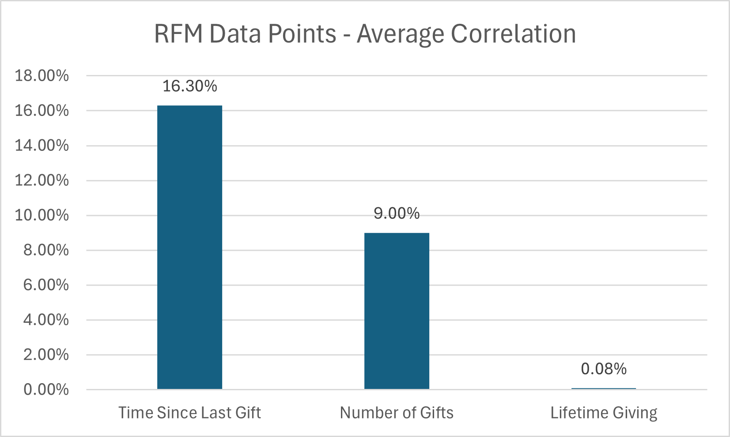
2. “Recency” and “Frequency” trump “Monetary Value”
“Number of gifts made” and “time since most recent gift” are more important than lifetime giving.

Slide 15
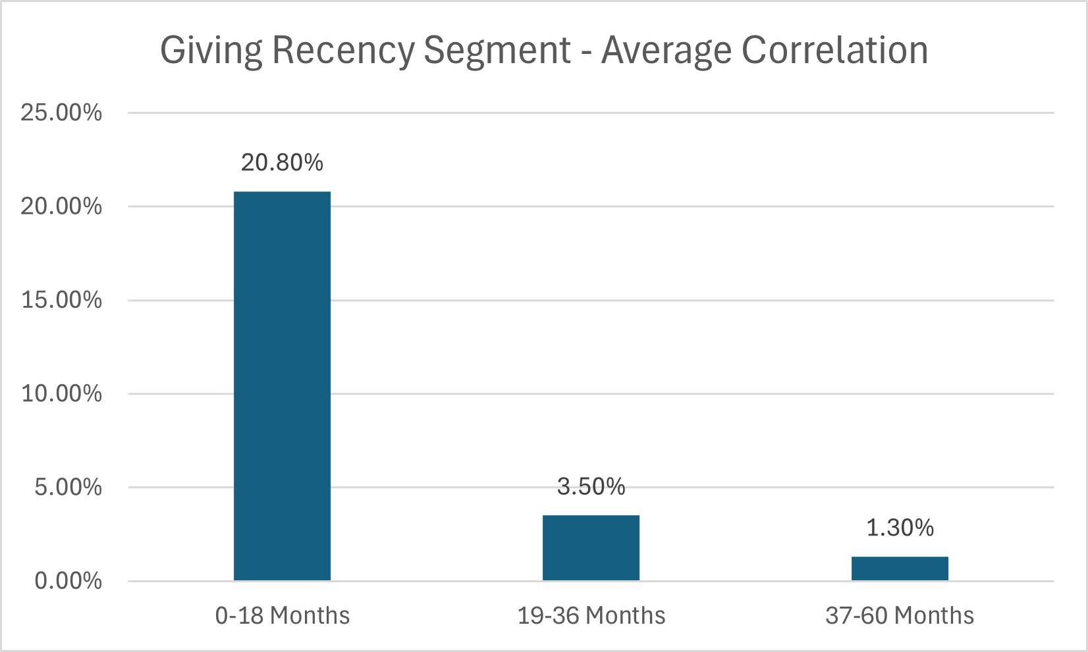
3. The “Recency” bump tails off hard after 18 months
Likelihood to give tapers off hard after 18 months since a donor’s last gift

Slide 16
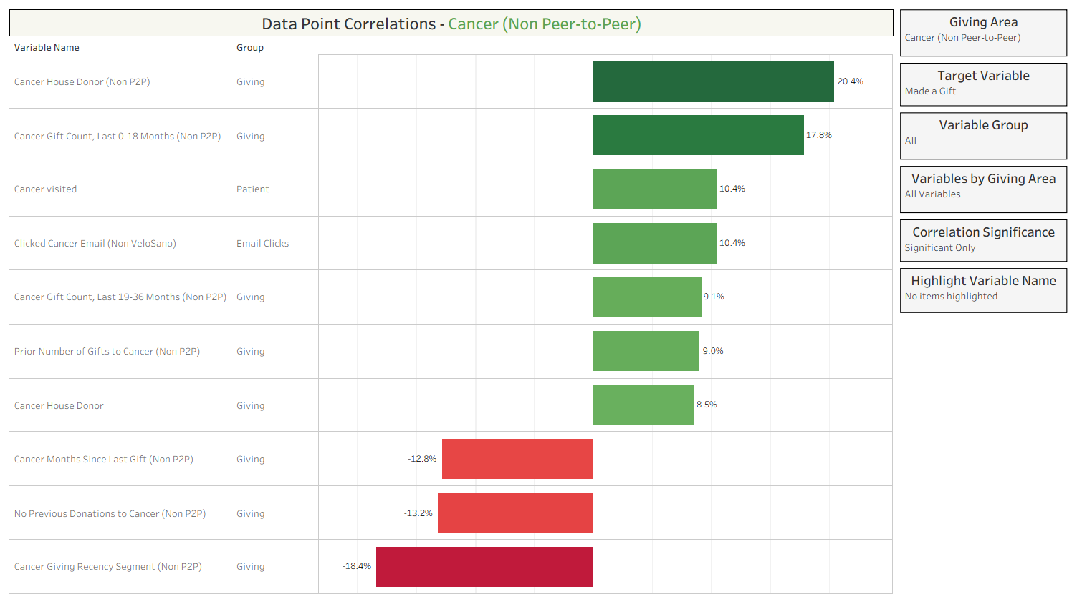
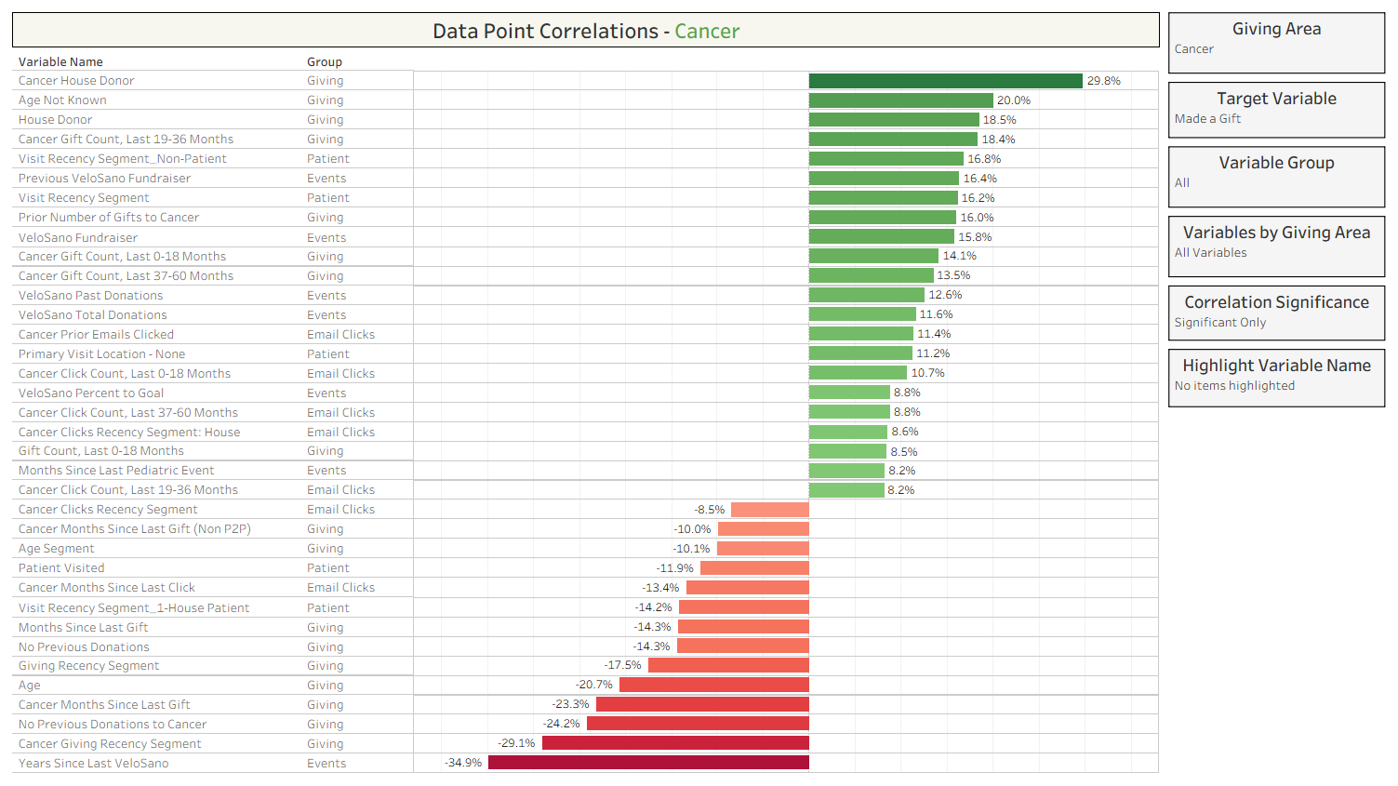
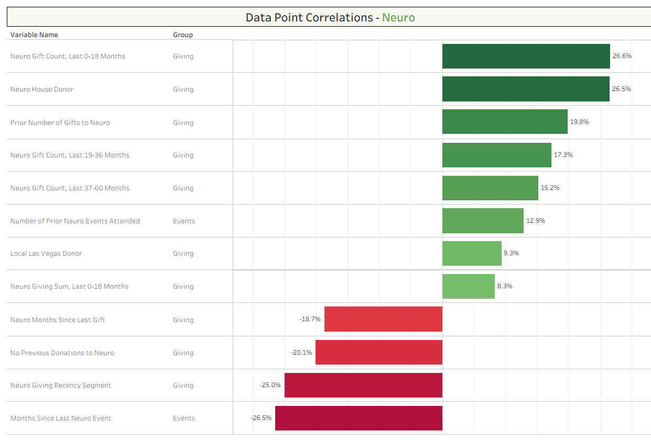
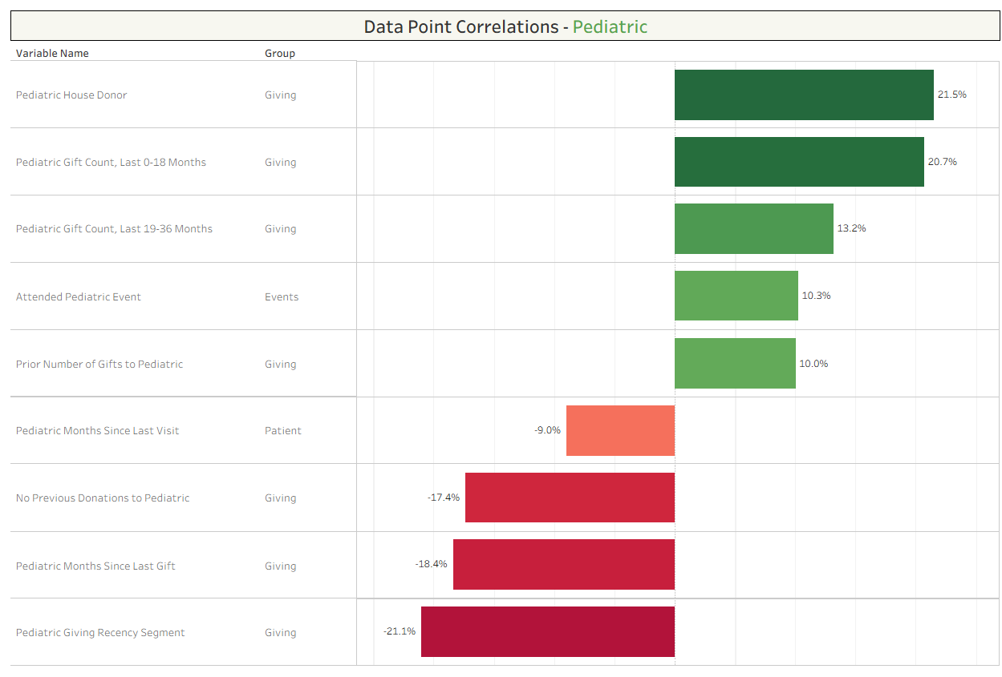
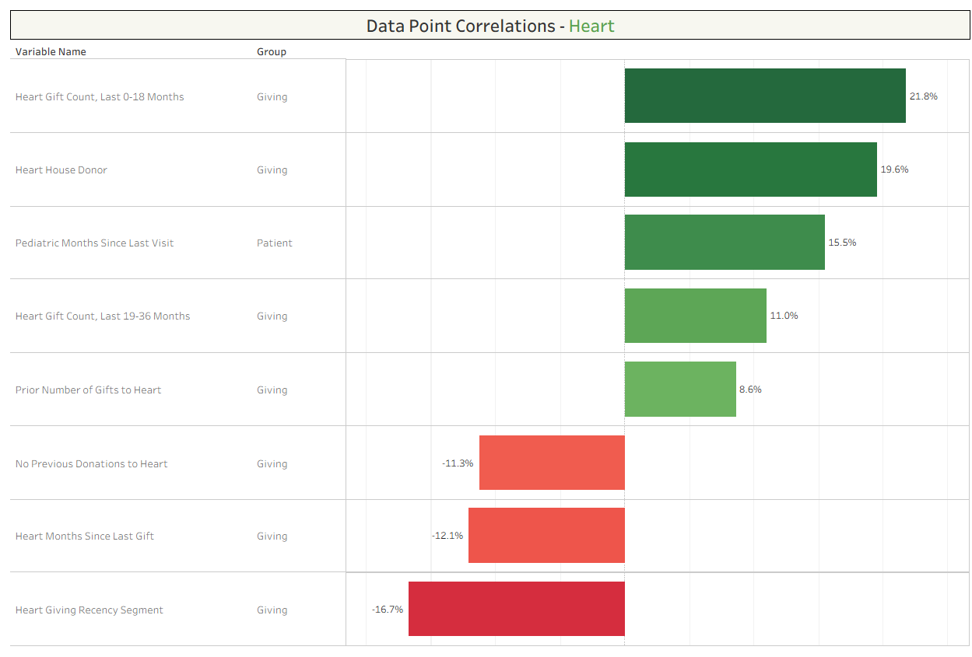
5. Cancer donors look way different… until you remove peer-to-peer gifts

Slide 17
4. Donors tend to find a giving area and stick with it
Giving to one interest area tends to not correlate
with giving to a different interest area

Slide 18
6. Patient variables work on a smaller scale…
Recency of patient visits follows a similar pattern as recency of giving,
albeit at a smaller correlation.

Slide 19
7. …and so do email clicks

Slide 20
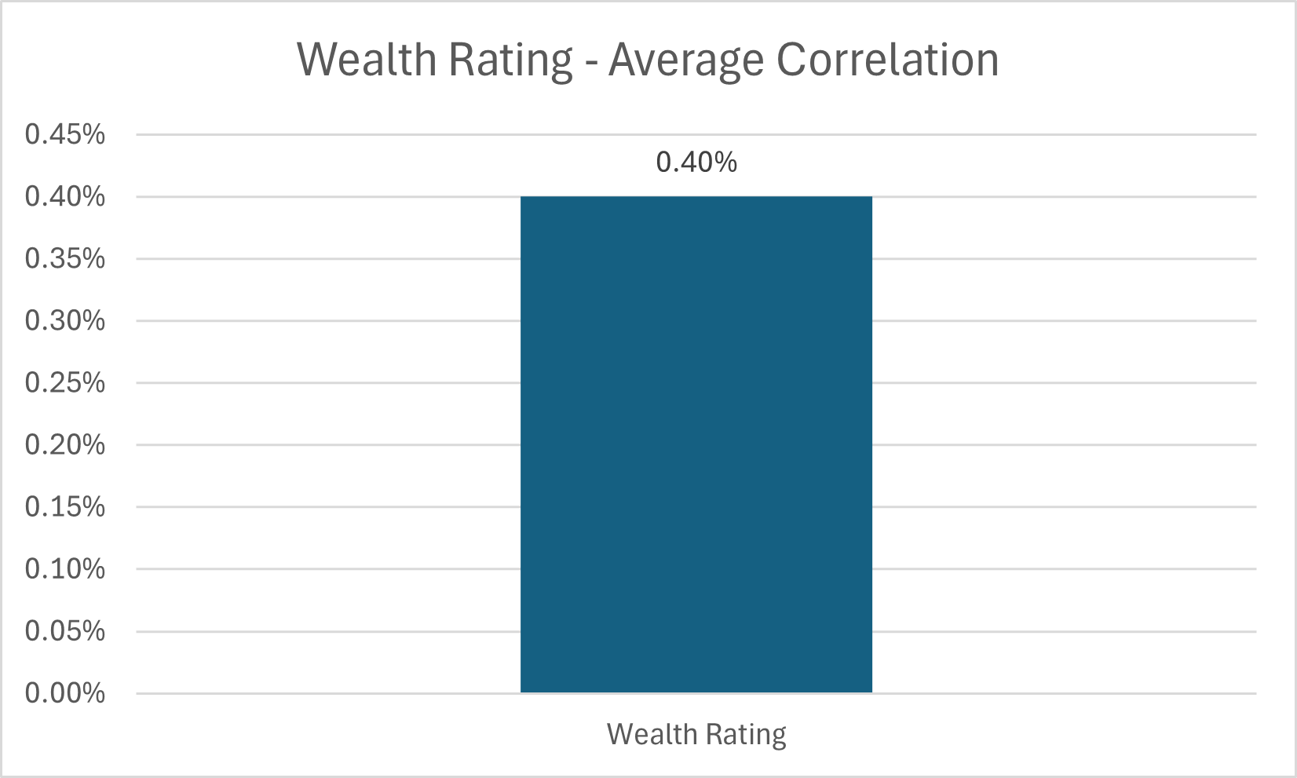
8. Capacity didn’t correlate
Wealth Rating by itself is not a useful predicter for individual giving

Slide 21
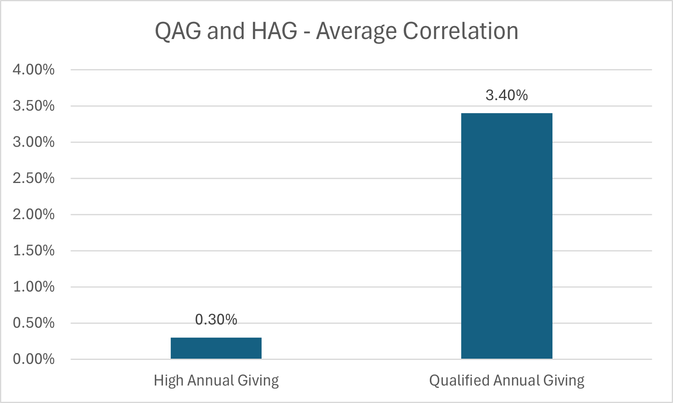
9. Neither did High or Qualified Annual Giving
…and neither is High Annual Giving (HAG)
(Qualified Annual Giving is slightly more useful)

Slide 22
10. Other interesting findings
Individuals who made a “nontraditional gift” in the past (not a check, credit card, or cash) were 10% more likely to make a gift again in the future.
Vegas donors and patients are 10% more likely to donate to Neurology.
Past cancer patients were 10% more likely to make a non peer-to-peer gift to Cancer.
Past pediatric event attendees were 10% more likely to make a gift to Pediatric again.

Slide 23
Part III: Building Predictive Models

